Slide 1
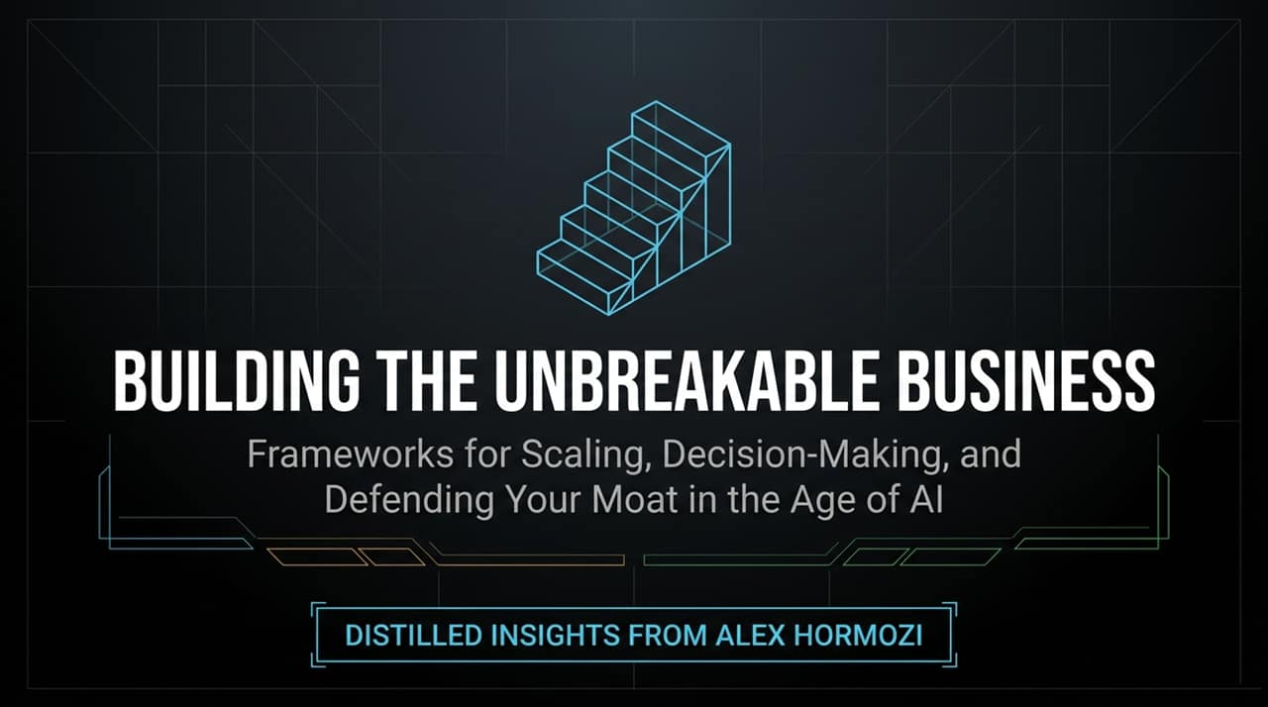
Notes:
https://www.youtube.com/watch?v=HwmwyBgzj8c
Good morning/afternoon, everyone. Today, we're discussing how to build an 'unbreakable business'—a company designed not just to survive disruption, but to scale predictably and compound over decades.
As featured in recent insights distilled from entrepreneur and investor Alex Hormozi, the modern landscape presents unprecedented tools—like AI—alongside massive traps.
The core thesis of today’s talk comes down to a fundamental truth: lengthening your time horizon is your single greatest competitive advantage.
Over the next few minutes, we’ll break down practical frameworks covering AI adoption, retention mathematics, unscalable pricing strategies, hiring realities, and emotional resilience.

Slide 2
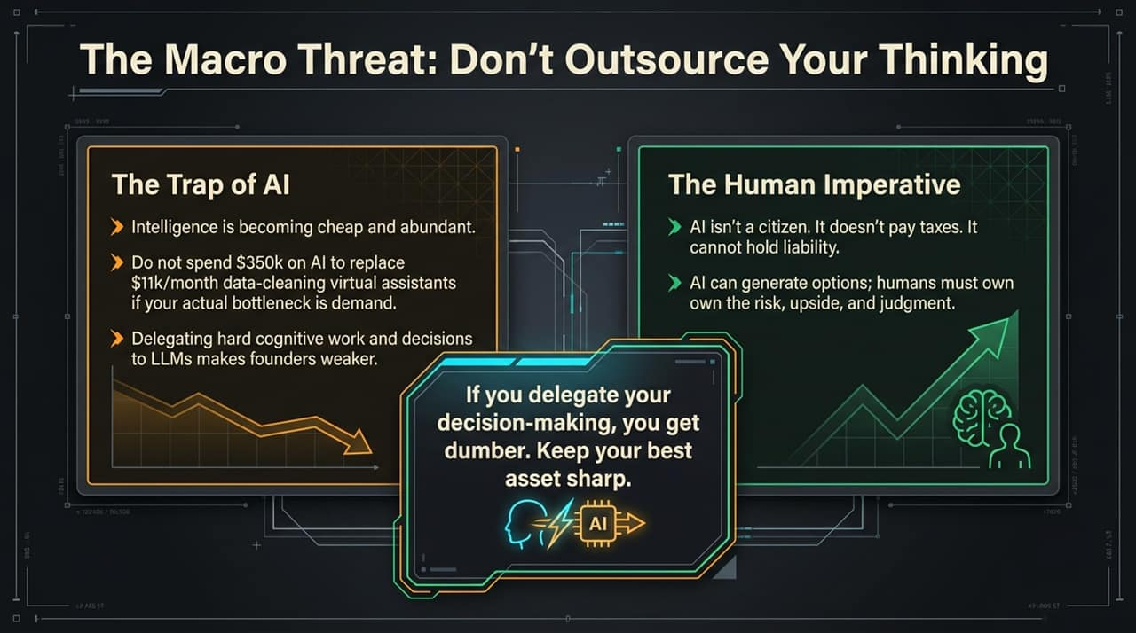
Notes:
Let's begin with the elephant in the room: AI. Right now, intelligence is becoming cheap and abundant. But there is a huge difference between using AI as a tool and outsourcing your core cognitive capability to it.
Alex Hormozi highlights a critical mistake founders are making today. He references a company that spent $350,000 trying to build a custom AI solution to replace $11,000/month virtual assistants who were cleaning data. They paid over three years' worth of costs upfront to automate a non-bottleneck. Their actual bottleneck was demand—getting more customers!
The Rule of Thumb for AI: Ask yourself, 'Is this making us more money right now?' Don't spend vast resources automating minor processes while ignoring the real constraint of your business.
The Human Imperative: Delegating high-stakes decisions and hard cognitive work to LLMs makes founders weaker. AI is not a legal entity, it doesn't pay taxes, and it cannot hold liability. LLMs generate options; humans must exercise judgment and own the risk.

Slide 3
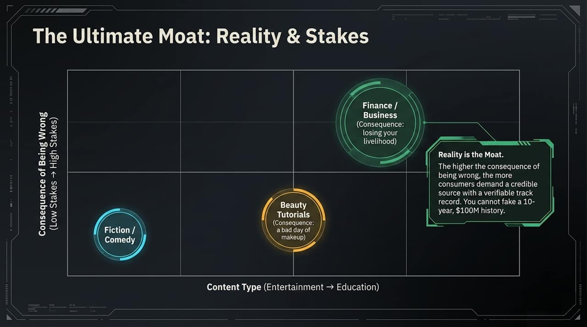
Notes:
When superintelligence becomes accessible to everyone, what becomes your moat?
Look at this 2x2 matrix measuring the consequence of being wrong against content type.
In low-stakes areas like fiction, comedy, or beauty tutorials, a wrong recommendation results in low impact—a bad day of makeup or a missed punchline. AI-generated media will flood these spaces.
However, in high-stakes areas like Finance, Business, or Healthcare, being wrong means losing your livelihood or health.
Reality is the Ultimate Moat. When the stakes are high, customers demand a credible, human source with a verifiable track record. You cannot fake a decade of real-world results or $100M in executed transactions. Focus heavily on building real-world proof and trust.

Slide 4
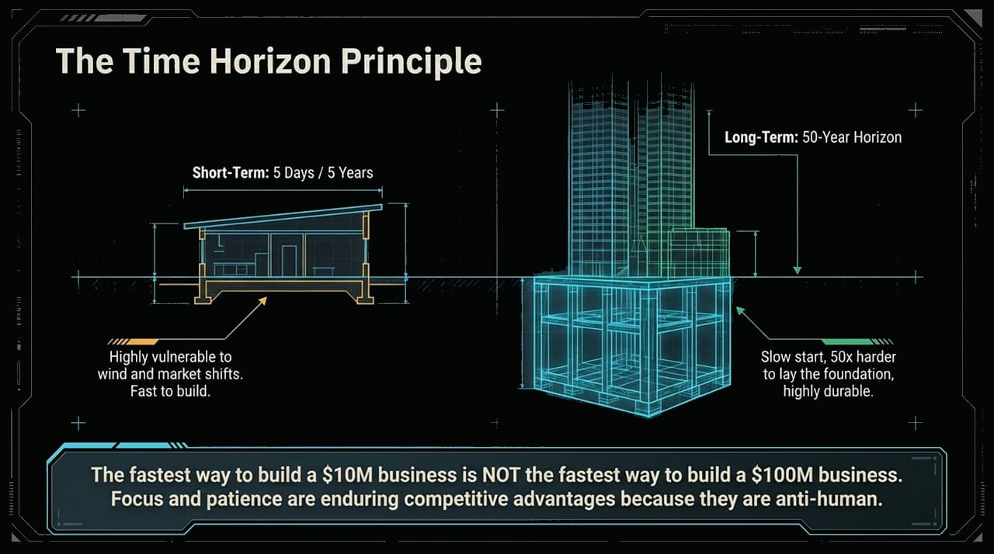
Notes:
This diagram illustrates the architectural principle of business building.
Building a shed takes 5 days and minimal foundation. It’s fast, but a severe storm will blow it over. Building a 100-story skyscraper requires digging a massive, deep foundation before you ever see a single floor above ground.
The $10M Trap: The fastest way to build a $10M business is NOT the fastest way to build a $100M business. If you optimize for fast immediate cash, you often build fragile structures with high churn and poor unit economics.
Focus and patience are enduring competitive advantages precisely because they are 'anti-human'. Human biology pushes us toward immediate gratification. Resisting that instinct allows you to out-build everyone else.

Slide 5
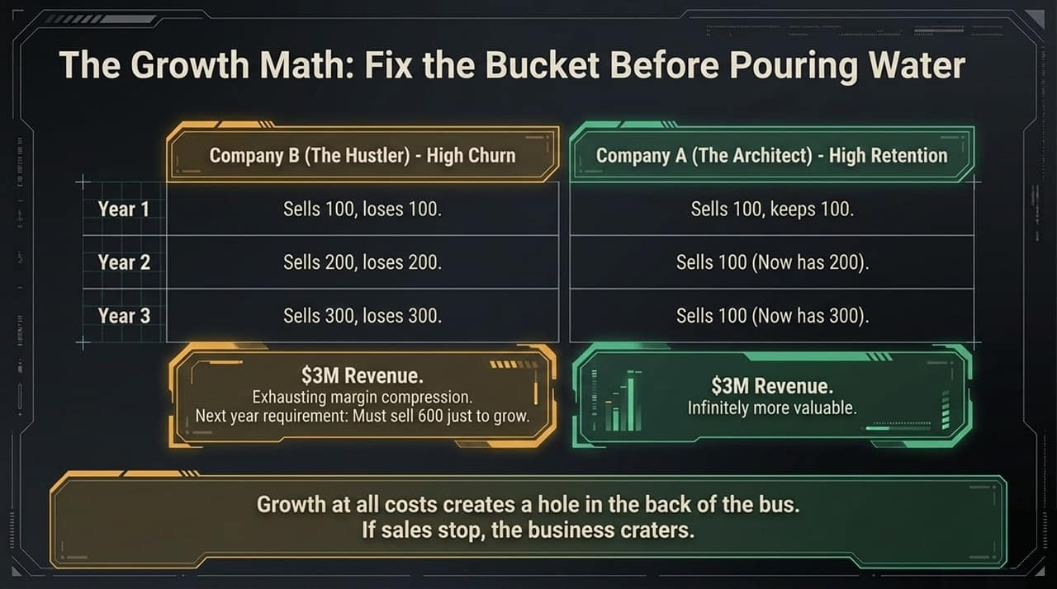
Notes:
Let's look at the math behind long-term enterprise value.
Company B (The Hustler): Sells 100 units in Year 1, but loses all 100 due to churn. To grow, they sell 200 in Year 2 and lose 200. By Year 3, they sell 300 and hit $3M in revenue. But look at the effort required: to grow next year, they must sell 600 just to stay ahead of the churn. They are running on a brutal treadmill.
Company A (The Architect): Focuses on product-market fit and retention. Sells 100 in Year 1 and keeps them. In Year 2, they sell another 100 (now at 200). In Year 3, they sell another 100 and reach $3M revenue.
Both companies hit $3M, but Company A is infinitely more valuable, far less stressed, and has compounding margins. Growth without retention is pouring water into a leaky bucket.

Slide 6
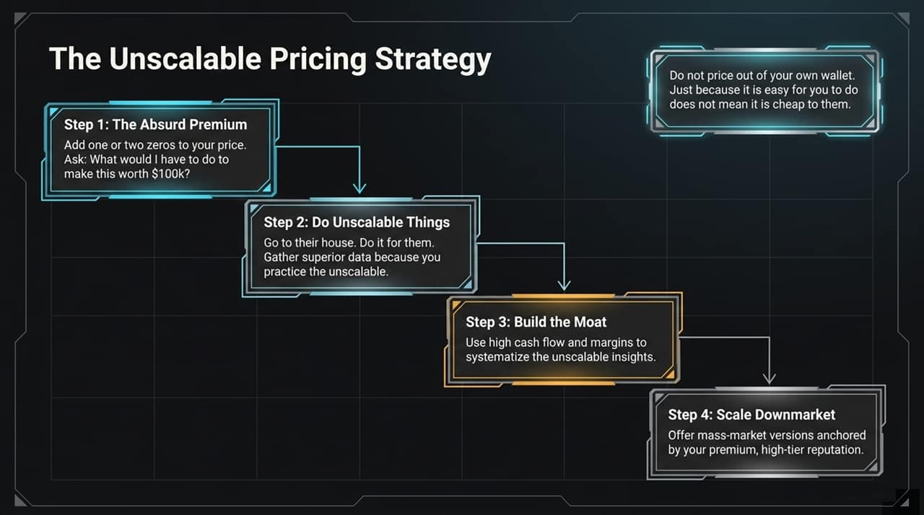
Notes:
How do high-value businesses launch premium offerings? By working backwards from value.
Step 1: The Absurd Premium. Add one or two zeros to your price tag. Ask: 'What would I have to do to make this worth $100k?' Don't price out of your own wallet; what is easy for you may be valuable to them.
Step 2: Do Unscalable Things. Fly to their location, do the heavy lifting for them, and gather deep operational data.
Step 3: Build the Moat. Use high cash flows and premium margins to systemize those unscalable insights into software, processes, or IP.
Step 4: Scale Downmarket. Offer mass-market versions anchored by the elite reputation of your high-tier product.

Slide 7
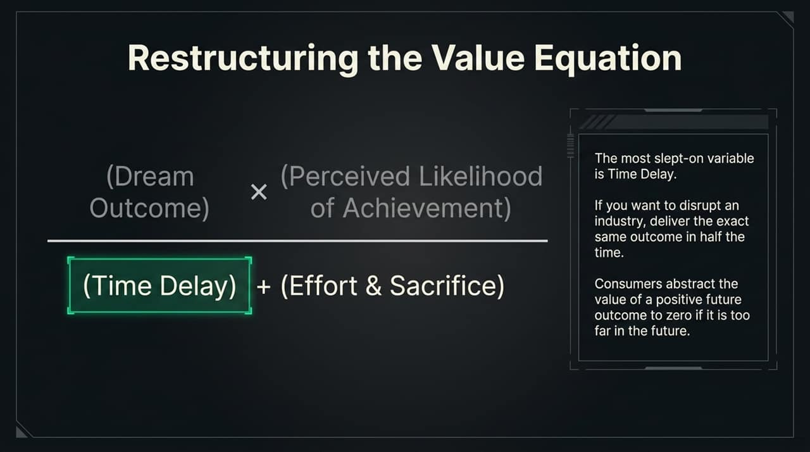
Notes:
The Value Equation measures value as: (Dream Outcome × Perceived Likelihood of Achievement) ÷ (Time Delay + Effort & Sacrifice).
The Time Delay Factor: Time delay is the most overlooked variable. If an outcome takes too long, consumers discount its value to near zero. To disrupt an industry, deliver the same outcome in half the time.
The Persuasion Framework: Consumers operate inside incentive structures. We don't create demand; we channel existing human desires.
If prospects aren't buying, you haven't made your desired action the most convenient, reward-rich, and risk-free option on the grid.

Slide 8
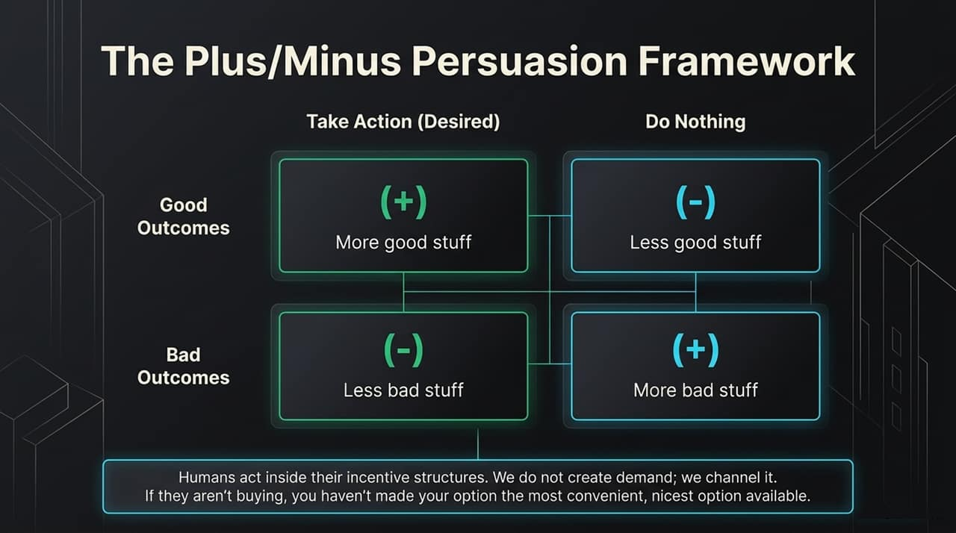

Slide 9
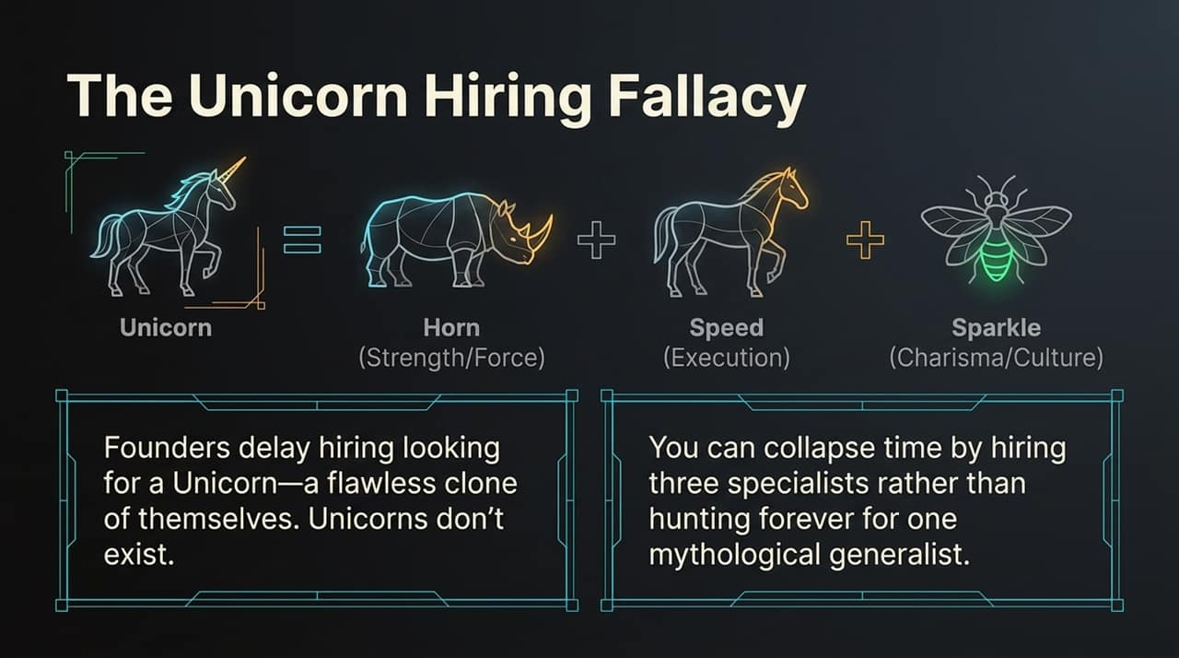
Notes:
A major bottleneck for growing founders is hiring.
Founders often delay hiring while hunting for a 'Unicorn'—a magical, flawless clone of themselves who possesses strategic foresight, charismatic selling, and technical execution.
Unicorns do not exist.
Instead of wasting months searching for one mythological generalist, collapse time by hiring three distinct specialists: one for strategy/force (Horn), one for culture/sales (Sparkle), and one for execution/speed (Speed).

Slide 10
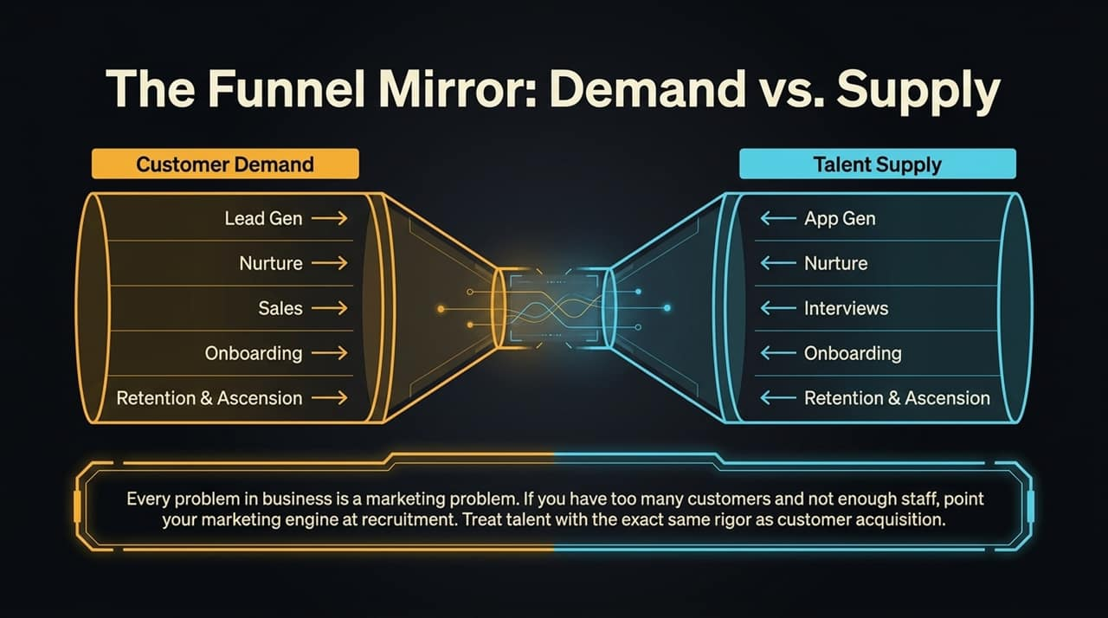
Notes:
Every operational problem in scaling is ultimately a marketing problem.
If your company has high customer demand but cannot fulfill orders or maintain quality, your constraint is talent supply.
Mirror your customer acquisition funnel directly onto recruitment:
Lead Gen becomes App Gen.
Lead Nurture becomes Candidate Nurture.
Sales becomes Interviews.
Onboarding & Retention remain identical for both.
Treat recruiting talent with the exact same rigor and ad-spend budget as acquiring new customers.

Slide 11
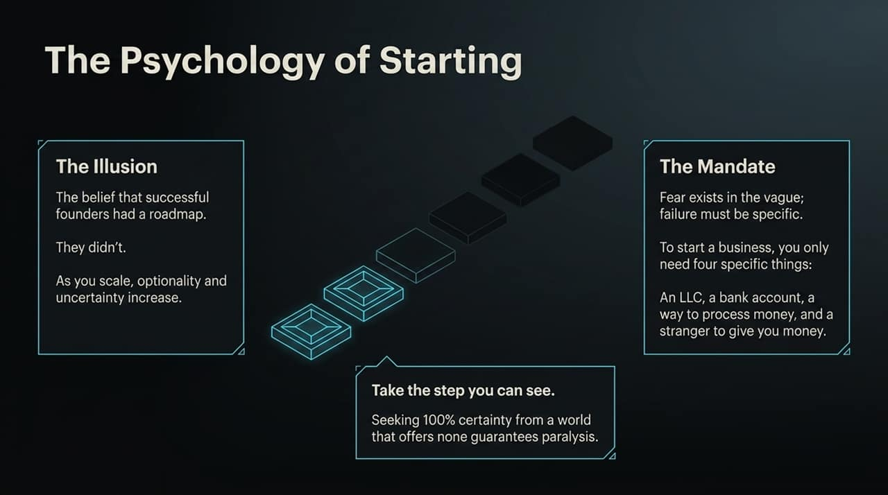
Notes:
Many aspiring entrepreneurs sit on the sidelines waiting for a complete 10-year roadmap.
The Illusion: Successful founders did not have a complete roadmap when they started. As you scale, ambiguity actually increases, not decreases. Seeking 100% certainty before acting guarantees paralysis.
The Mandate: Fear thrives in vagueness. Make your requirements specific. To launch a business, you only need four tangible things:
An LLC/Entity
A bank account
A payment processor
A stranger willing to give you money for value.

Slide 12
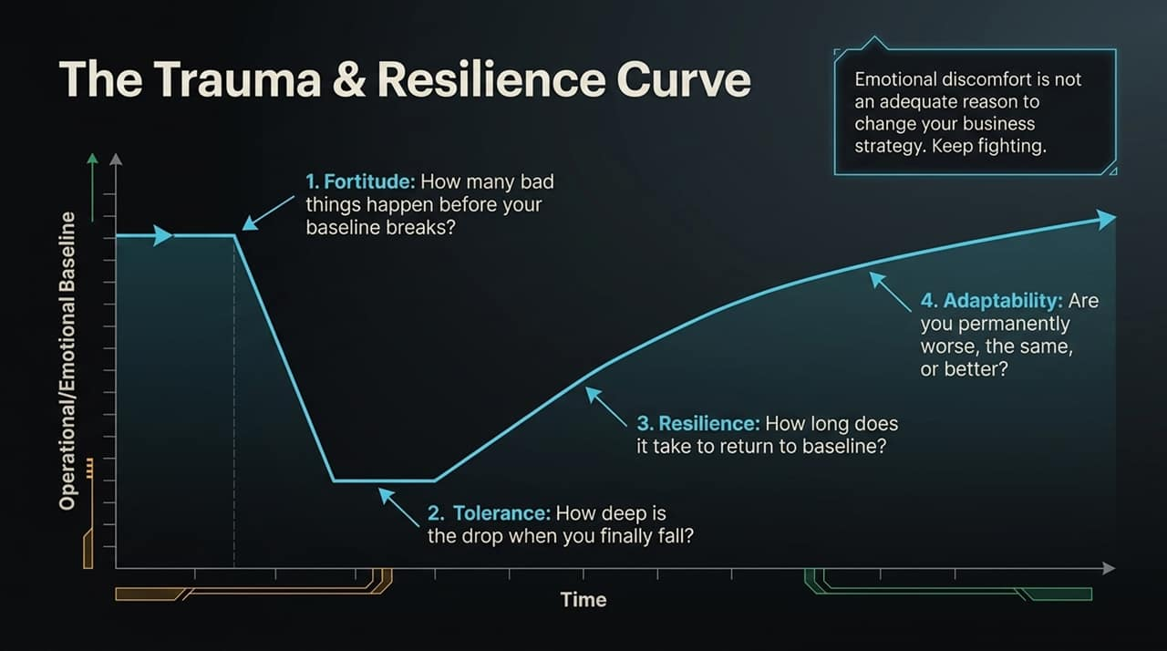
Notes:
In business, you will encounter painful setbacks—lost key clients, team departures, or operational crises.
Alex Hormozi highlights a critical mental rule: Emotional discomfort is NOT an adequate reason to change your business strategy.
Measure your psychological game across four metrics:
Fortitude: How many bad events can occur before your baseline breaks?
Tolerance: How deep is your operational/emotional dip when things go wrong?
Resilience: How quickly do you return to baseline?
Adaptability: Do you return permanently better, or permanently broken?

Slide 13
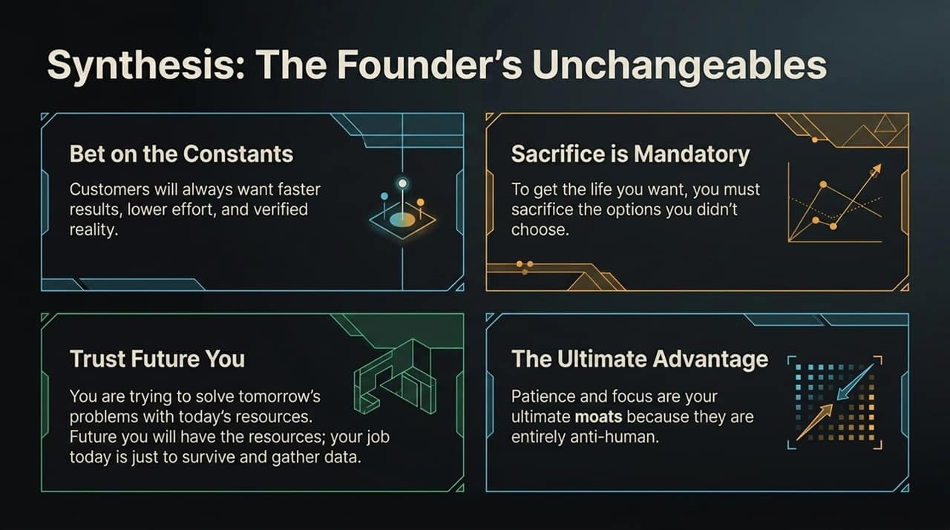
Notes:
To wrap up our blueprint, let's synthesize the unchangeable truths of business leadership:
1. Bet on the Constants: Technology changes, but fundamental human desires do not. Customers will always want faster outcomes, higher certainty, and lower effort.
2. Sacrifice is Mandatory: You cannot keep every door open. True focus means sacrificing good opportunities to pursue the extraordinary one.
3. Trust 'Future You': Stop trying to solve Year 5 problems with Year 1 resources. Focus on surviving and gathering data today; your future self will have the capital and team to solve future problems.
4. Embrace Long Horizons: Patience and focus are your ultimate moats.
Thank you for your time. Let's open the floor to Q&A.

Slide 14
